Slide 1


DIGITAL PORTFOLIO
STUDENT NAME :
A.NAFILA FARVEEN.
REGISTER NO :
24134130500122009
NMID :
asanm41341324213009 / 8578D14A3C41458B02D4E2848A3C8B93
DEPARTMENT :
BCA
COLLEGE :
DEEN COLLEGE OF ARTS AND SCIENCE
NIDUR
- KADUVANGUDI

Slide 2
STUDENT
DIGITAL
PORTFOLIO

Slide 3
AGENDA
​☆ Problem Statement
☆ Project Overview
​☆ End Users
​☆ Tools and Technologies
​☆ Portfolio design and Layout
​☆ Features and Functionality
​☆ Results and Screenshots
​☆ Conclusion
​☆ Github Link

Slide 4
PROBLEM
STATEMENT
The traditional resume often fails to fully capture a student's
skill and project work, making it difficult for them
to stand out to employers and academic institutions

Slide 5
PROJECT
OVERVIEW
To create an interactive digital portfolio website that allows a student to professionally showcase their academic projects, technical skills, and personal achievements in a visually appealing and organized manner.

Slide 6
WHO ARE THE END USERS
☆ Students :
The creators of the portfolio, who want a professional platform to present their work.
☆ Recruiters/Hiring Managers :
Professionals who need to quickly assess a candidate's abilities and project experience.
☆ Academic Institutions :
Admissions officers evaluating applicants for graduate programs.

Slide 7
TOOLS AND TECHNIQUES
☆ HTML:
The foundational language for structuring the portfolio's content, including headings, paragraphs, and sections.
☆ CSS:
Used for styling the website to control its layout, colors, fonts, and responsiveness.
☆ JavaScript:
Adds interactivity, such as smooth scrolling for navigation, dynamic content loading, and form validation.
☆ Git & GitHub:
For version control, allowing the student to manage project code and collaborate effectively.
☆ Deployment:
The portfolio can be hosted for free using services like GitHub Pages or Netlify, making it accessible to anyone
with an internet connection.

Slide 8
PORTFOLIO DESIGN AND LAYOUT
DESIGN
​ ◇ Simple Color Scheme:
The portfolio uses a limited color palette for a professional and clean look.
​ ◇ Visual Hierarchy:
Different font sizes and weights are used to guide the user's eye and emphasize key information.

Slide 9
LAYOUT
​◇ Clean, Minimalist, and Responsive:
The overall layout is uncluttered and adapts well to different screen sizes.
​◇ Header:
The top of the page includes the student's name, a brief tagline, and a navigation
bar.
​◇ Dedicated Sections:
The content is organized into separate sections, each with its own clear heading
like "About" or "Projects."

Slide 10
FEATURES AND FUNCTIONALITY
FEATURES
◇ ​Project Showcase:
A section for students to display their work, including a title, description, and links to the
project and its code.
​◇ Skill Highlight:
A simple, updatable list of technical skills.
​◇ Professional Contact Information:
A section with contact details and links to professional profiles like LinkedIn. and GitHub.
..

Slide 11
FUNCTIONALITY
◇ ​Interactive Navigation:
The navigation provides a smooth scrolling animation when links are
clicked , instead of an abrupt jump.
​◇ Responsiveness:
The layout adjusts to different screen sizes, ensuring a good user
experience on both desktop and mobile devices.

Slide 12
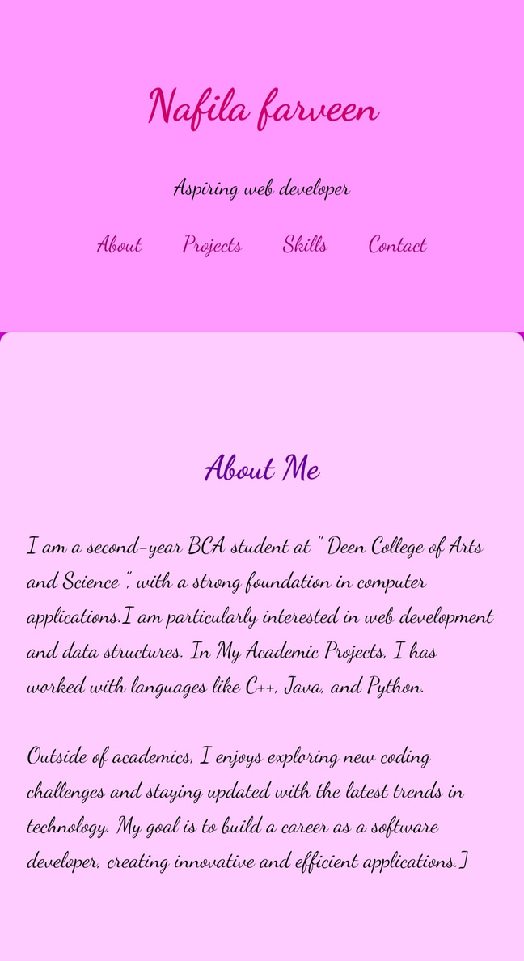
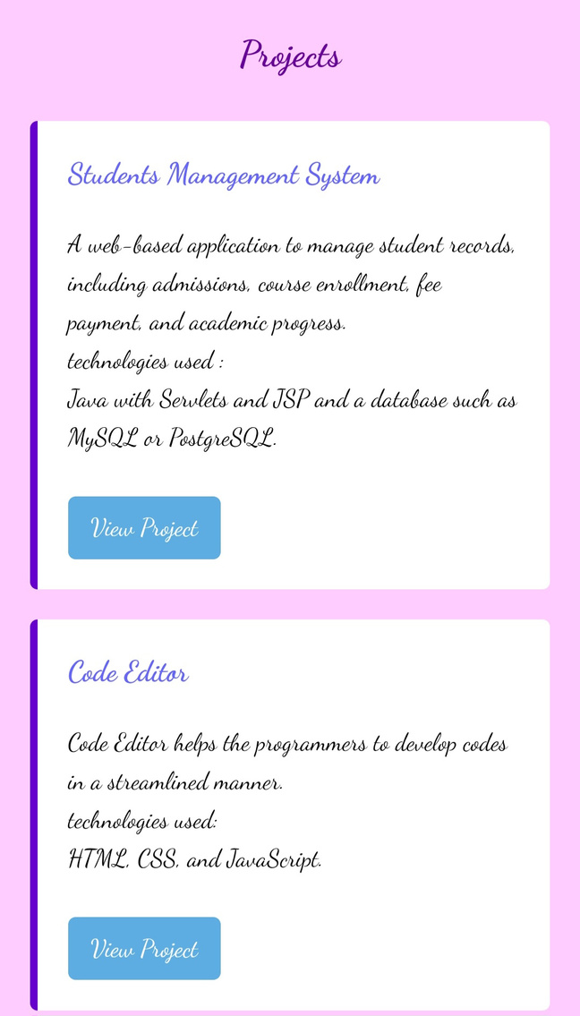
RESULTS AND SCREENSHOT

Slide 13
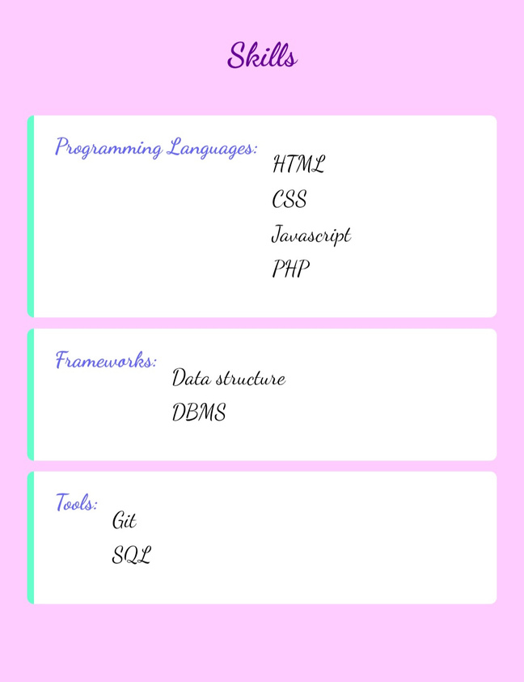
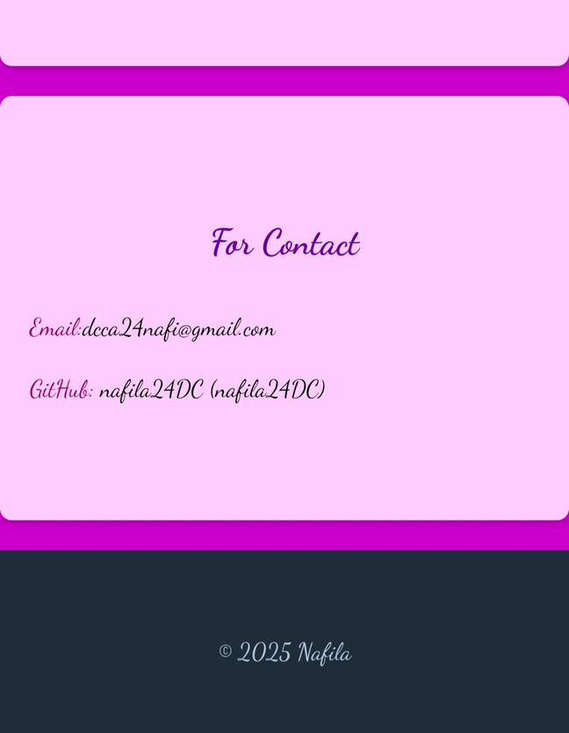
RESULTS AND SCREENSHOT

Slide 14
CONCLUSION
☆ Highlights of Projects:
Nafila's projects, a Student Management System and a Code
Editor, show her practical skills in both front-end and
back-end development.
☆ Benefits to Society:
Her projects offer real-world benefits, from improving school
administration to helping programmers work more efficiently.
☆ Final Summary:
This portfolio effectively proves Nafila's potential as a software
developer by showcasing her foundational knowledge and
applied project skills.

Slide 15
GITHUB LINK
https://github.com/nafila24DC/Nafila-TNSDC-FWD-DP.git

